Slide 1
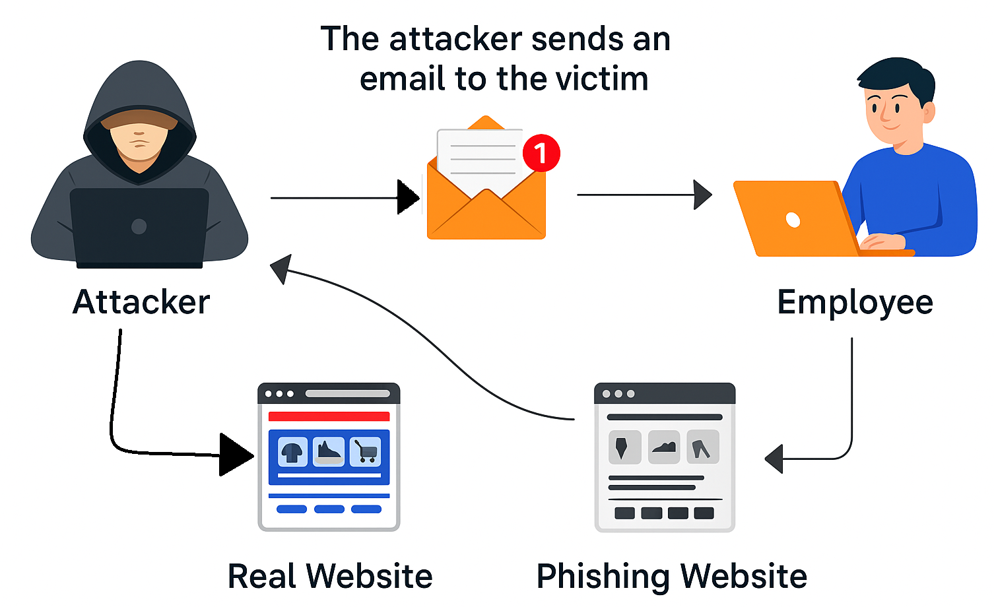
Phishing Email Detection using BERT
Theory + Code understanding

Slide 2
Problem Statement
Phishing emails trick users into revealing sensitive information like passwords or financial data.
Manual detection is error-prone and not scalable.
Existing spam filters often miss cleverly crafted phishing content.
There is a growing need for an automated system to detect phishing emails with high accuracy.
The goal is to build a machine learning model using BERT to classify emails as phishing or legitimate based on their textual content.

Slide 3
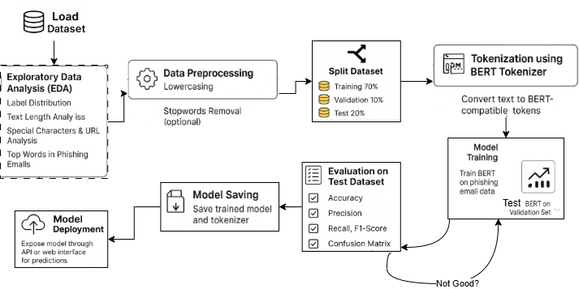
Architecture of the project
Fine-Tuned BERT Model for Phishing Email Detection

Slide 4
Data set explanation
https://www.kaggle.com/datasets/naserabdullahalam/phishing-email-dataset?select=phishing_email.csv

Slide 5
Tokenizer

